Slide 1

Final Project - Bean Vibes – Android App Solution
Erdun E
CS5200 Database Management Systems
Introduction
System Architecture
Results
Description of the Problem
Project Motivation
ERD diagram
Your chance to shine! You can include screenshots of your application and what your accomplished
System Description
What does the system do? What does it solve? Dataset, Functionality, features, limitations
Database design, considerations, queries, etc
Conclusion
Discussions on what was produced, what still needs to be done if you had more time
Acknowledgements
This presentation is supported by Khoury College, Northeastern University - Miami Campus.

Slide 2

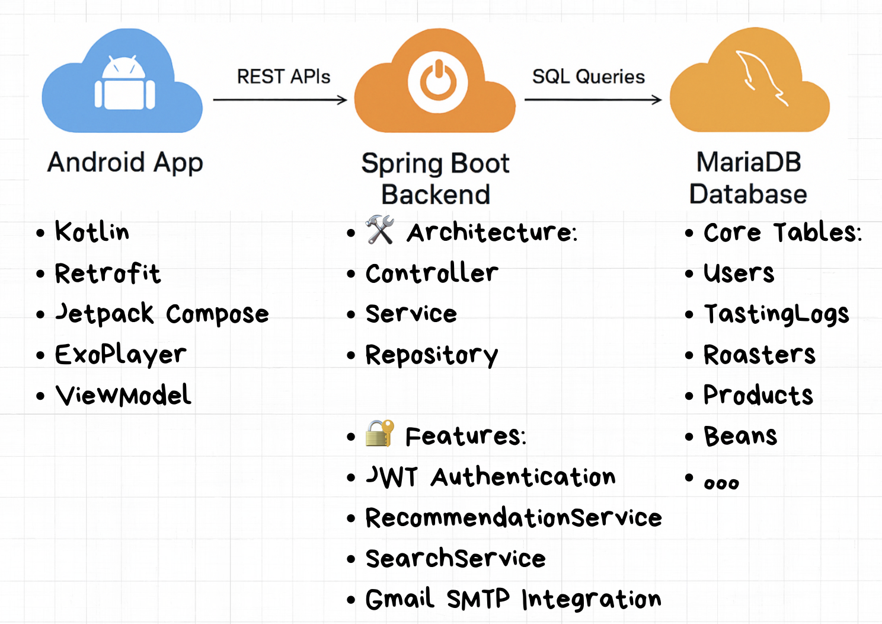
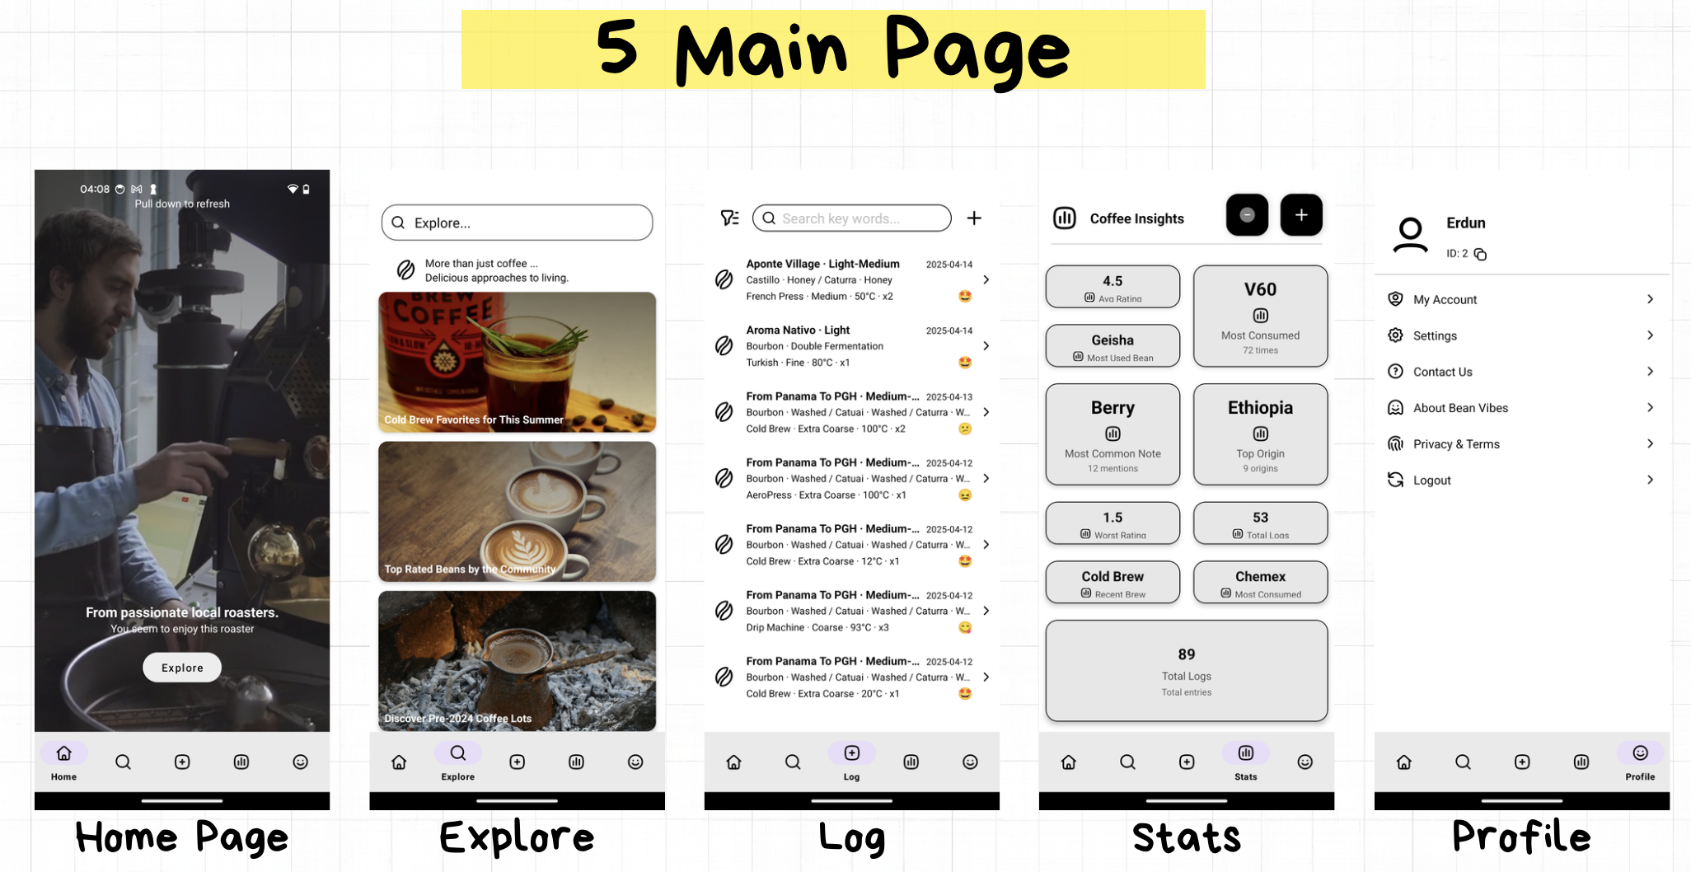
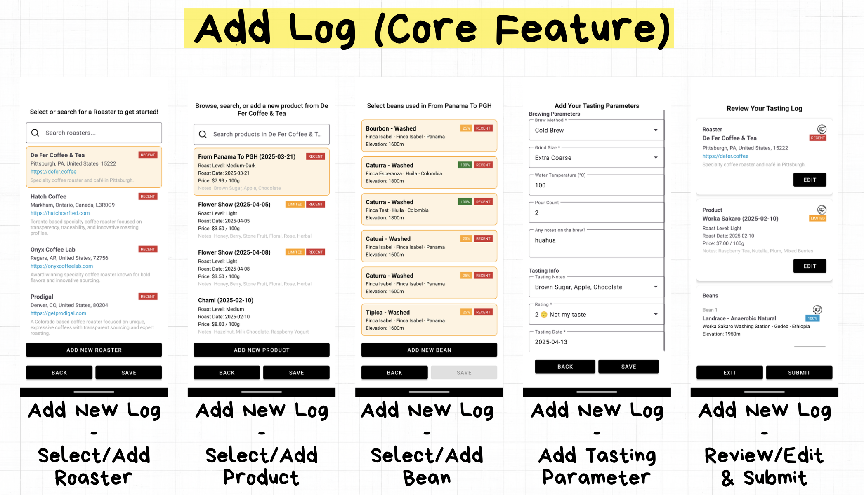
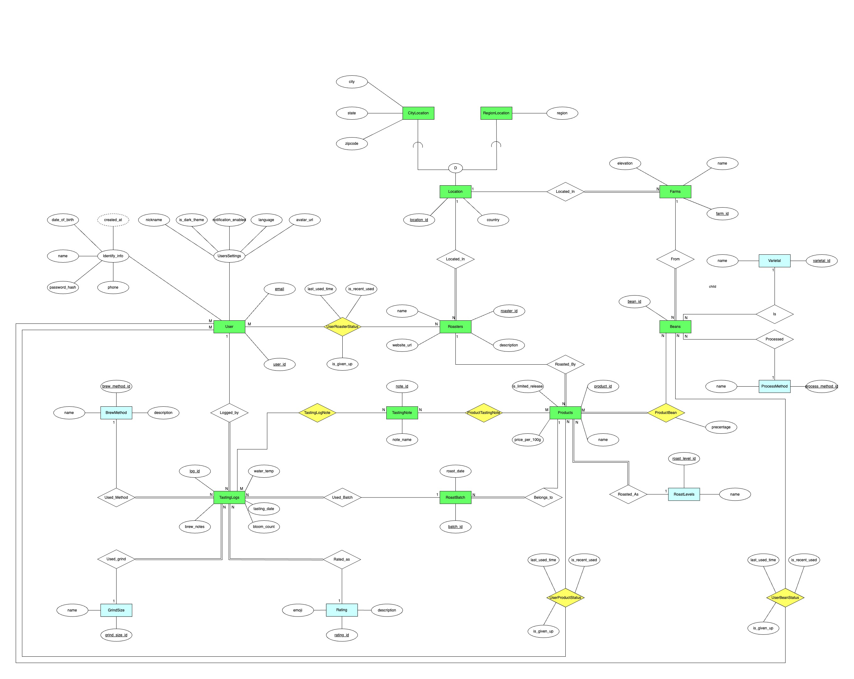
Bean Vibes – Android App Solution
Erdun E
CS5200 Database Management Systems
Introduction
System Architecture
Feature Highlights
Many coffee drinkers explore different beans and brewing styles, but often lack a way to remember what they liked or disliked.
Bean Vibes was created to give specialty coffee lovers a structured system to log, analyze, and revisit their tasting experiences.
The goal is to simplify note-taking, uncover flavor preferences, and make it easier to discover new products through data-driven recommendations.
Database design, considerations, queries, etc
System Design
Recommendation Logic
[User Tasting Logs]
↓
[Analyze Ratings / Notes / Brew Method/etc..]
↓
[Native SQL Queries/ Intelligent Model(future)]
↓
[Top Matching Products/Roaster/Beans/ etc.]
Conclusion
Acknowledgements
Core features completed. Future improvements could include dashboard integration, richer statistics, and user authentication for broader deployment.
This presentation is supported by Khoury College, Northeastern University - Miami Campus.

